Slide 1

FINAL PRESENTATION OF MINI PROJECT
On the Topic
Predicting Insurance Premium for Life Insurance Applicants using Machine Learning
Project Members: | Akher Uddin Ahmed (202102022100) Birhang Borgoyary (202102023126) Subhash Kumar Wary (202002022110)
Project Supervisor: | Mr. Prasanta Baruah Assistant Professor Dept. of Computer Science & Engineering
Central Institute of Technology Kokrajhar
Computer Science & Engineering
Predicting Insurance Premium for Life Insurance Applicants using Machine Learning
May 9, 2024

Slide 2
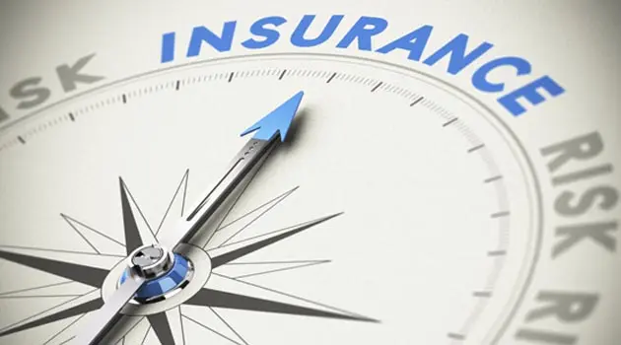
CONTENTS
Introduction
Objectives
Problem Statement
Block Diagram
Methodology
Dataset
Results and Analysis
Conclusion
Future Scope
References
Predicting Insurance Premium for Life Insurance Applicants using Machine Learning
May 9, 2024

Slide 3
INTRODUCTION
Life Insurance plays a crucial role in securing the financial well-being of loved ones in the event of an unexpected demise.
However, determining the appropriate premium for each policyholder involves a complex premium assessment process. Traditionally, this process relies on human underwriters who analyze various factors like age, health history and lifestyle etc.
Machine learning (ML) techniques has revolutionized the insurance industry, offering new opportunities to enhance the accuracy and efficiency of premium assessment processes.
By leveraging ML, insurers can streamline the underwriting process, reduce costs and improve premium prediction accuracy, ultimately providing better coverage options for policyholders
Predicting Insurance Premium for Life Insurance Applicants using Machine Learning
May 9, 2024

Slide 4
OBJECTIVES
To develop a machine learning model that can accurately predict the premium based on various features.
To provide accurate predictions which can be used to provide early analysis for Life Insurance Company.
The proposed solution for ML based premium prediction presents cost-effective and reliable solution.
This approach believes that using the Machine Learning, Life Insurance Company can be benefited.
Predicting Insurance Premium for Life Insurance Applicants using Machine Learning
May 9, 2024

Slide 5
PROBLEM STATEMENT
To build an efficient model which can predict premium of a Life Insurance Applicant.
Implementing latest technological advancements such as Machine learning.
Specific Life Insurance Policy can be suggested to applicants based on predicted result.
Predicting Insurance Premium for Life Insurance Applicants using Machine Learning
May 9, 2024

Slide 6
METHODOLOGY
Pre-processing of data has been done before training the model.
80% (1070) data has been taken for training and 20% (268) data taken for testing.
The model has trained with the various algorithms such as Linear Regression, Random Forest Regressor, Support Vector Regressor and Gradient Boosting Regressor.
Various machine learning algorithms were compared and Gradient Boosting Regressor model was selected as the best option for prediction.
Predict the result using the trained model on the input data and provide the prediction.
Predicting Insurance Premium for Life Insurance Applicants using Machine Learning
May 9, 2024

Slide 7
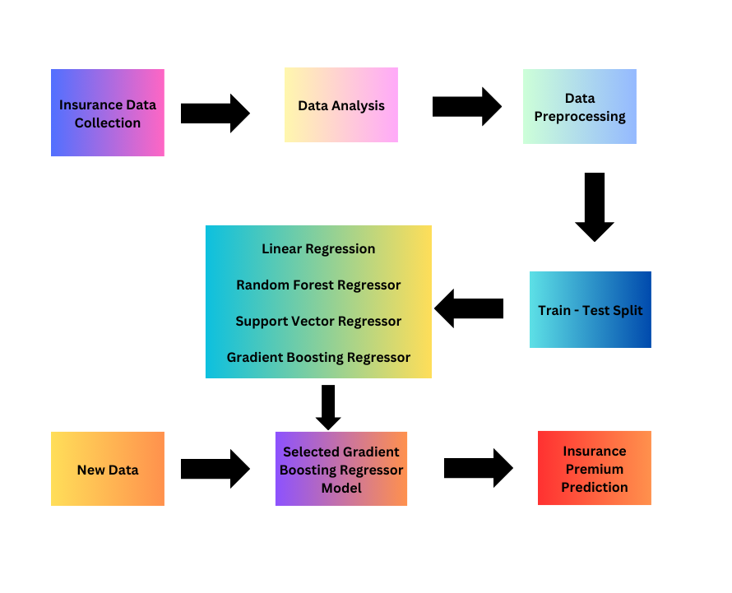
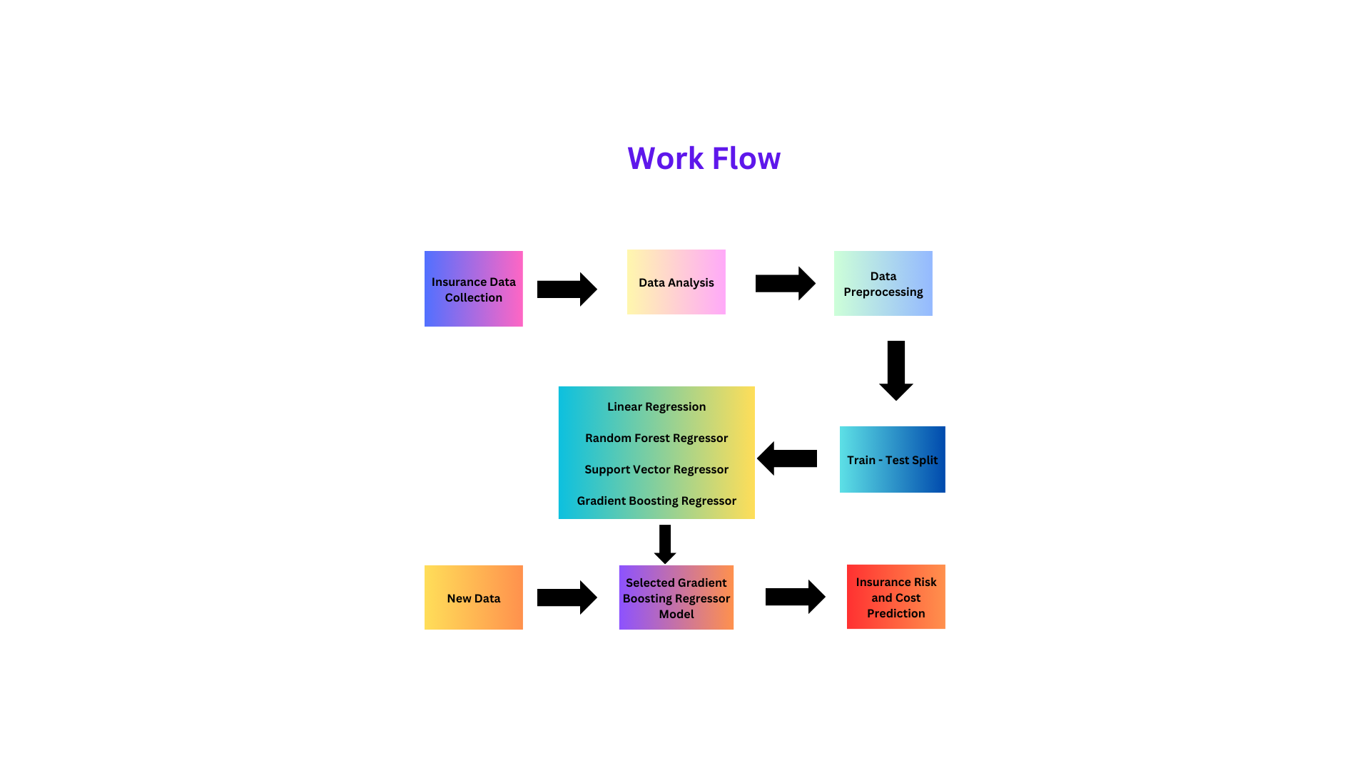
BLOCK DIAGRAM
Fig. 1: Block Diagram
Predicting Insurance Premium for Life Insurance Applicants using Machine Learning
May 9, 2024

Slide 8
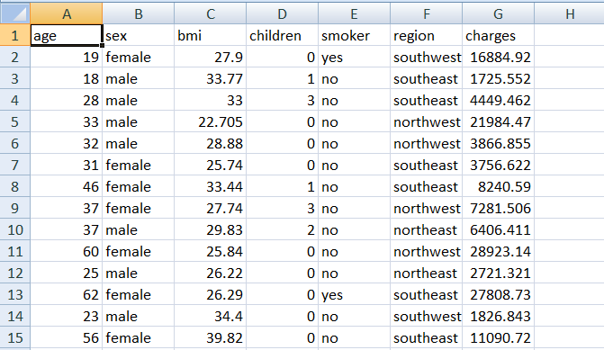
DATASET
Dataset has been taken from Kaggle containing the features Age, Sex, BMI, Children, Smoker, Region and Charges.
Table 1: Insurance Dataset
Total Number of Rows and Columns in our Dataset are 1338 and 7 respectively
Predicting Insurance Premium for Life Insurance Applicants using Machine Learning
May 9, 2024

Slide 9
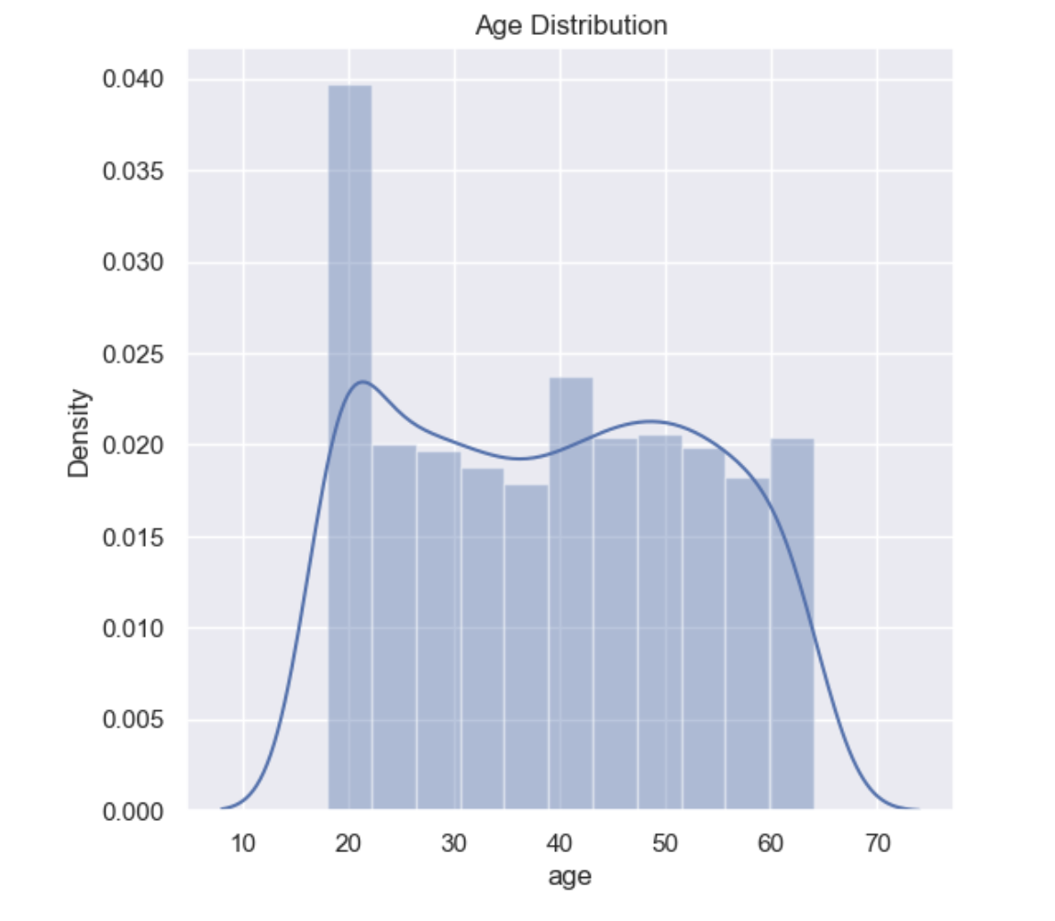
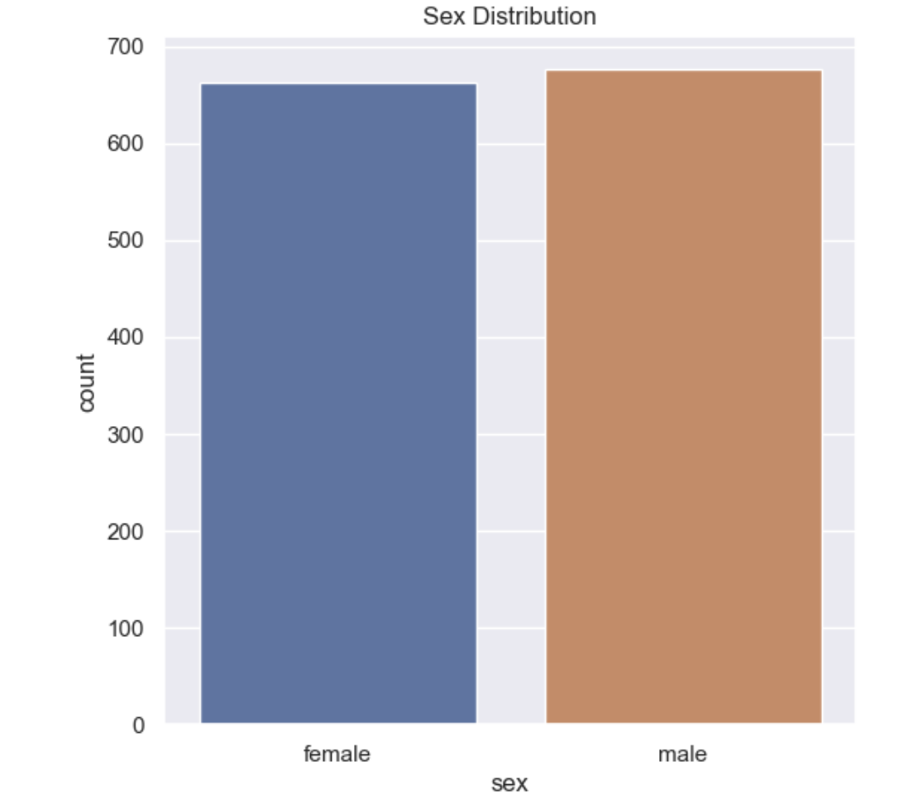
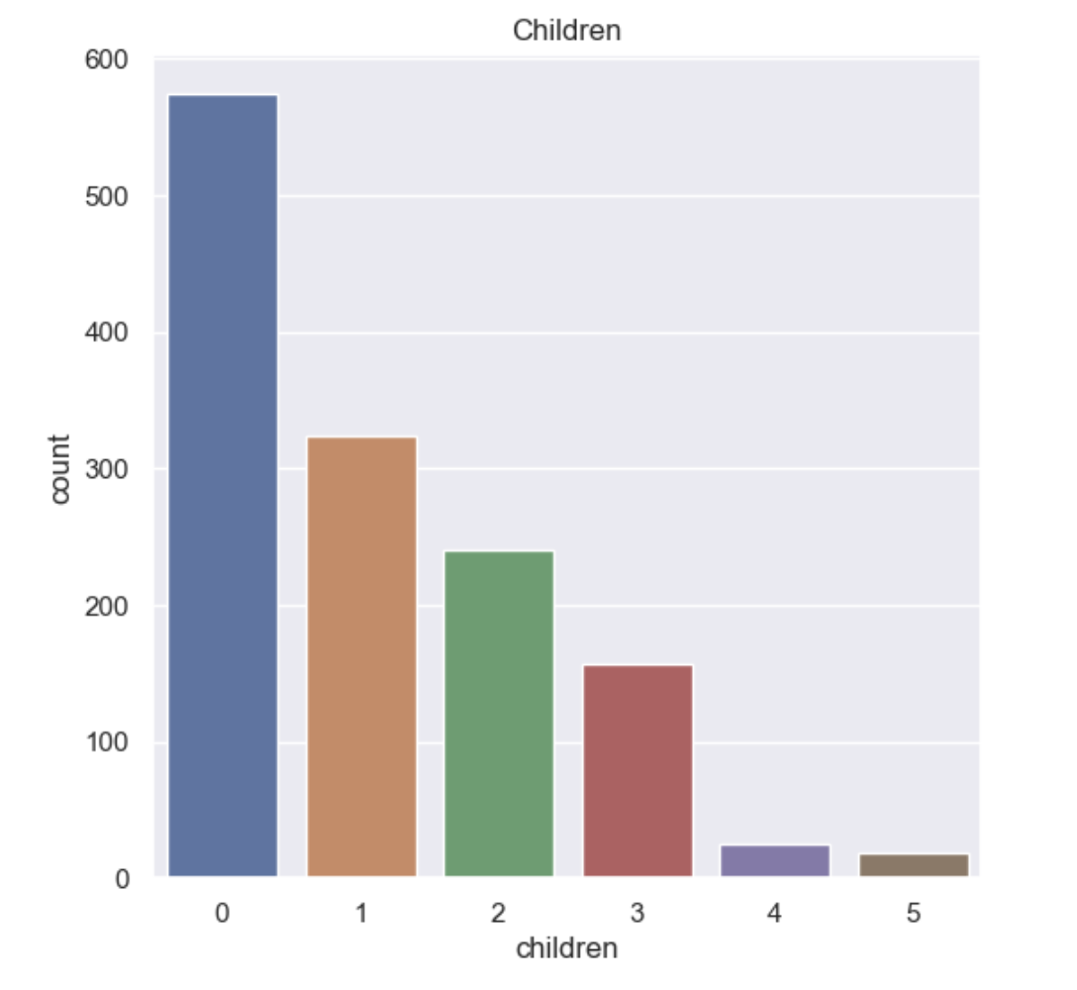
DATASET
Fig. 2: Age Distribution Fig. 3: Sex Distribution Fig. 4: Children Distribution
Predicting Insurance Premium for Life Insurance Applicants using Machine Learning
May 9, 2024

Slide 10
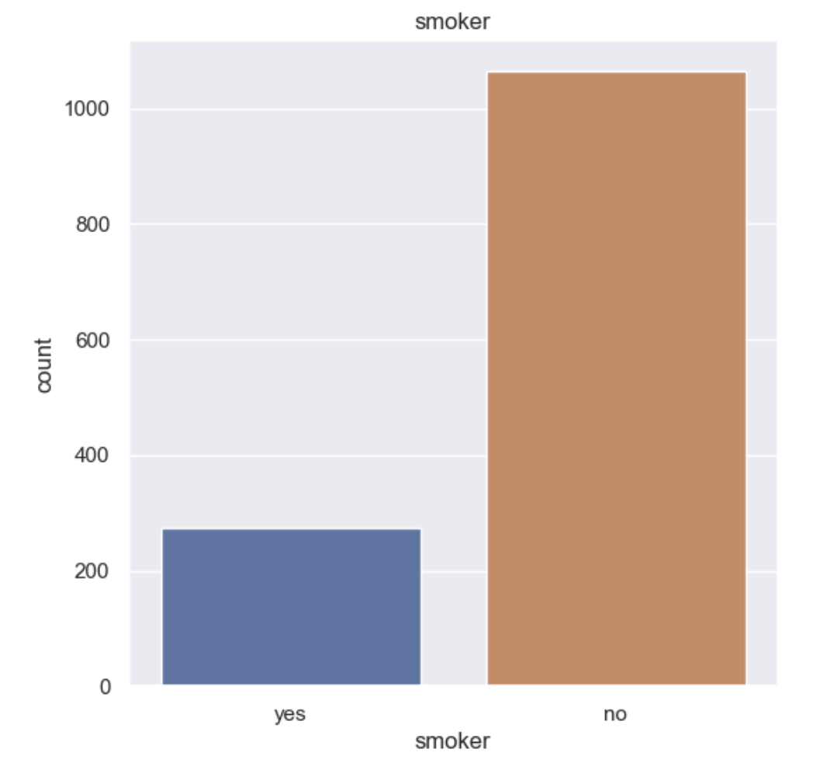
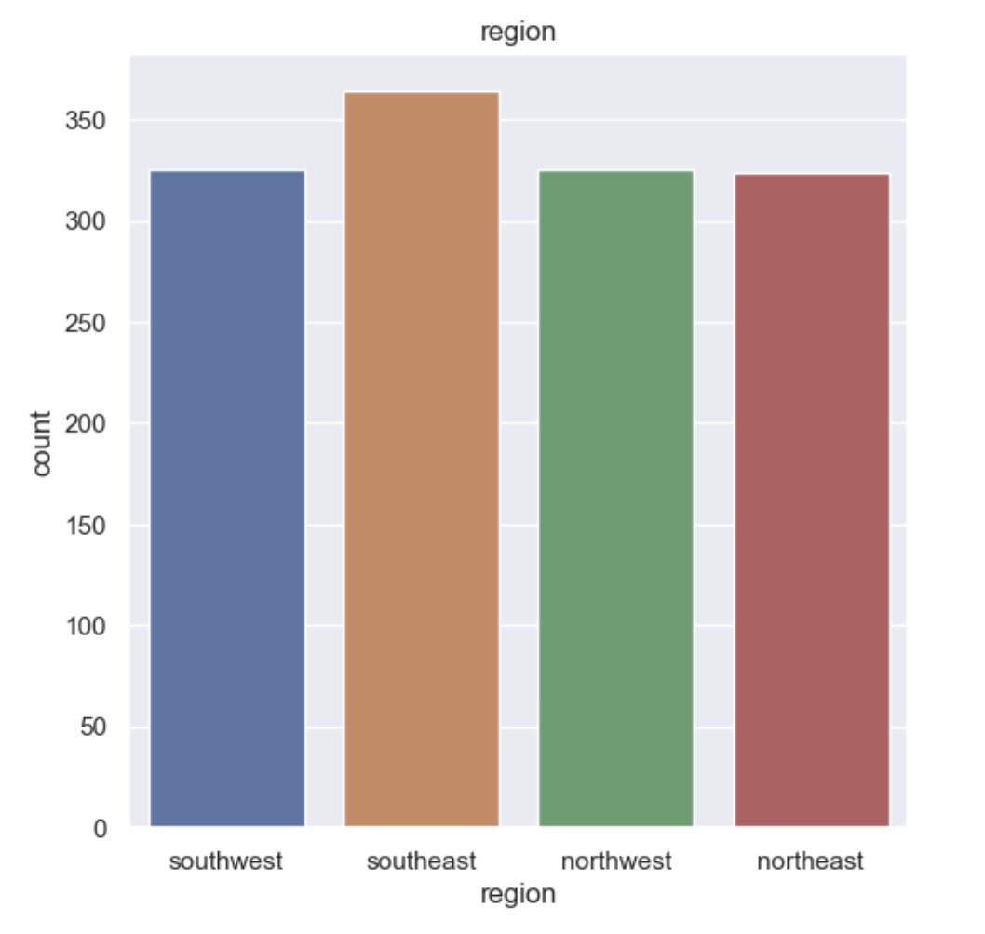
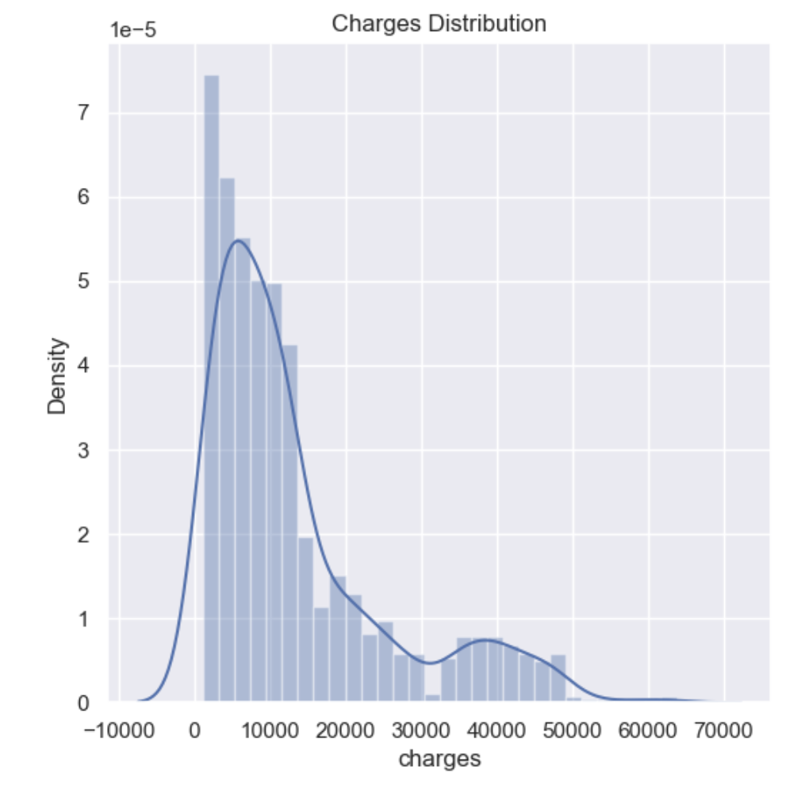
DATASET
Fig. 5: Smoker Distribution Fig. 6: Region Distribution Fig. 7: Charges Distribution
Predicting Insurance Premium for Life Insurance Applicants using Machine Learning
May 9, 2024

Slide 11
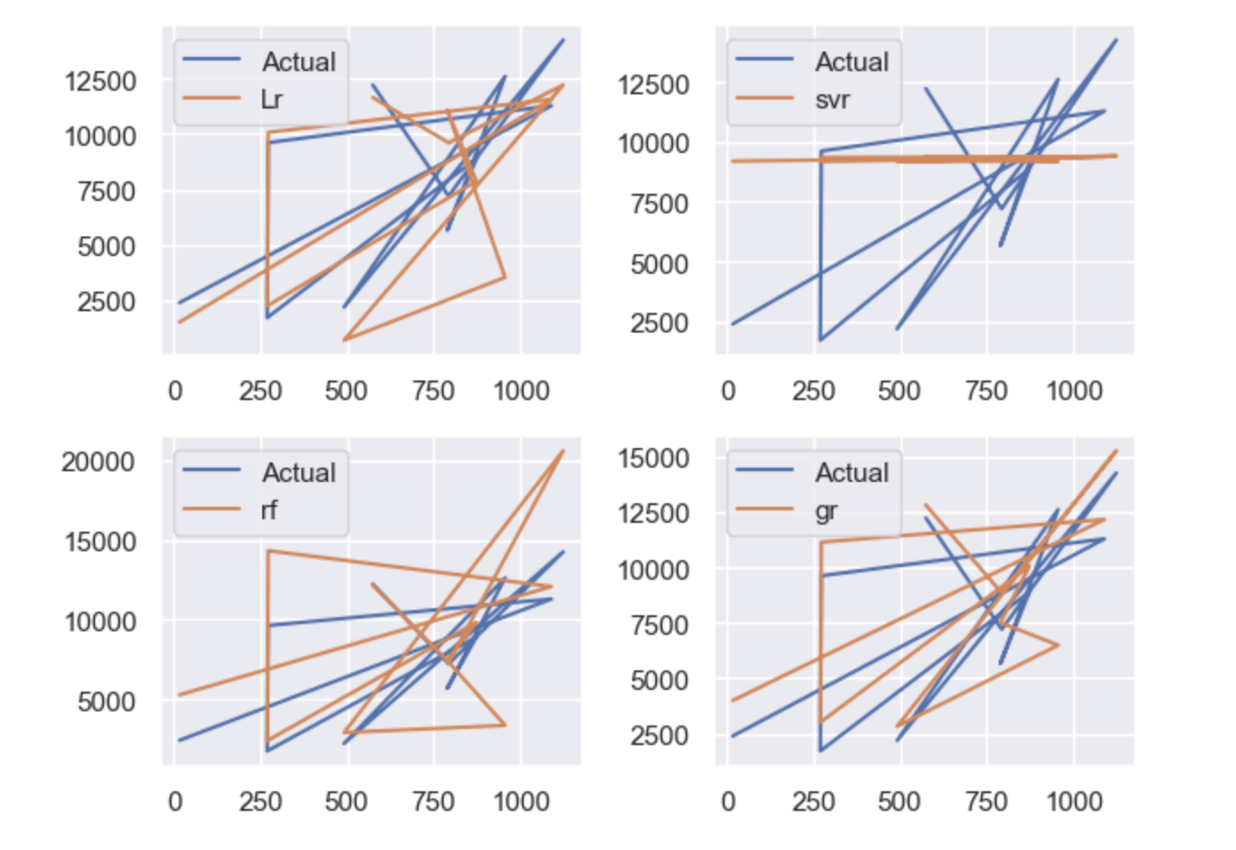
RESULTS and ANALYSIS
M-1
M-2
:
M-3
M-4
Fig. 8: Compare Performance Visually
Predicting Insurance Premium for Life Insurance Applicants using Machine Learning
May 9, 2024

Slide 12
RESULTS and ANALYSIS
Table 2: Accuracy Score of Different ML Algorithms
Algorithms Name | Accuracy Score
Linear Regression | 74%
Random Forest Regressor | 83%
Support Vector Regressor | 8%
Gradient Boosting Regressor | 86%
Predicting Insurance Premium for Life Insurance Applicants using Machine Learning
May 9, 2024

Slide 13
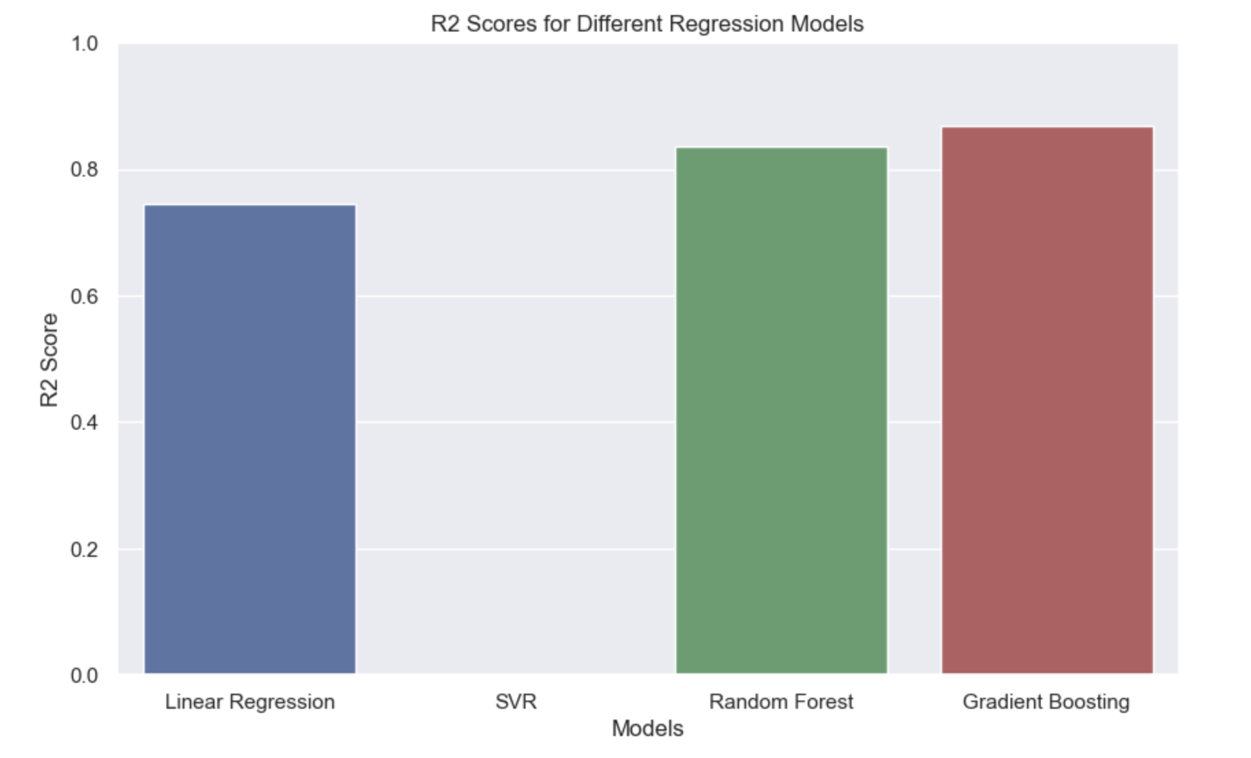
RESULTS and ANALYSIS
:
Fig. 9: R2 Scores for Different Regression Models
Predicting Insurance Premium for Life Insurance Applicants using Machine Learning
May 9, 2024

Slide 14
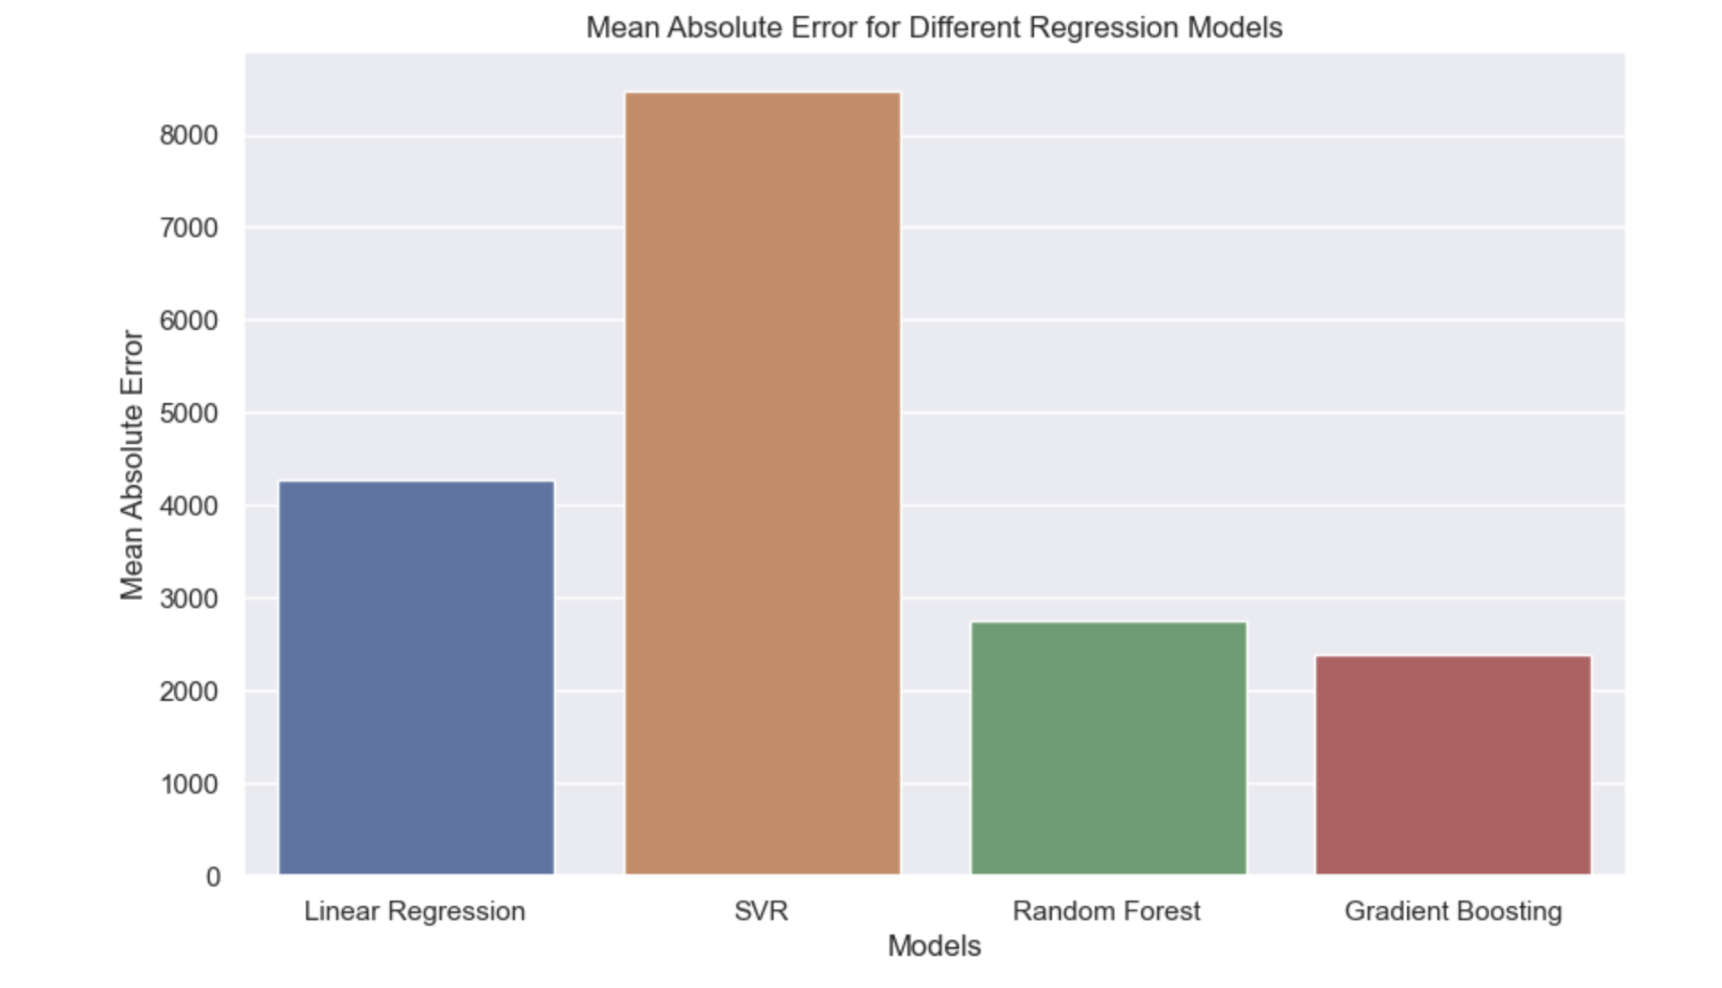
RESULTS and ANALYSIS
Table: Accuracy of Different ML Algorithms
Fig. 10: Mean Absolute Error for Different Regression Models
Predicting Insurance Premium for Life Insurance Applicants using Machine Learning
May 9, 2024

Slide 15
CONCLUSION
,
Based on the analysis among the algorithms Linear Regression, Random Forest Regressor, Support Vector Regressor and Gradient Boosting Regressor. The Gradient Boosting Regressor algorithm is giving the accuracy of 86% which is the highest among all.
Gradient Boosting Regressor model is used to predict the premium of the life insurance applicant and can be suggested as better model to the Life Insurance Company.
Predicting Insurance Premium for Life Insurance Applicants using Machine Learning
May 9, 2024

Slide 16
FUTURE SCOPE
,
Continuous improvements in machine learning algorithms enhance accuracy and efficiency in assessing premium profiles.
Availability of large datasets enables the development of more sophisticated models for predicting individual premium.
Machine learning facilitates better understanding and management of premiums, contributing to overall improvements in the Life Insurance industry.
Implementation of GIS (Geographical Information System) and finding the best prediction.
Predicting Insurance Premium for Life Insurance Applicants using Machine Learning
May 9, 2024

Slide 17
,
REFERENCES
Rahul Sahai, Ali Al-Ataby, Sulaf Assi, Manoj Jayabalan, Panagiotis Liatsis, Chong Kim Loy, Abdullah Al-Hamid, Sahar Al-Sudani, Maitham Alamran and Hoshang Kolivand, “Insurance Risk Prediction Using Machine Learning”, April 2023
Siti Nurasyikin Shamsuddin, Noriszura Ismail and R. Nur-Firyal, “Life Insurance Prediction and Its Sustainability Using Machine Learning Approach”, July 2023
Keshav Kaushik, Akashdeep Bhardwaj, Ashutosh Dhar Dwivedi, and Rajani Singh, “Machine Learning-Based Regression Framework to Predict Health Insurance Premiums”, June 2022
Noorhannah Boodhun & Manoj Jayabalan, “Risk prediction in life insurance industry using supervised learning algorithms” April 2018
Prasanta Baruah & Pankaj Pratap Singh, “Risk Prediction in Life Insurance Industry Using Machine Learning Techniques — A Review”, September 2023
Predicting Insurance Premium for Life Insurance Applicants using Machine Learning
May 9, 2024

Slide 18
Thank You
Predicting Insurance Premium for Life Insurance Applicants using Machine Learning
May 9, 2024

